Slide 1
Tutorial 02
Getting Started with CSS

Slide 2
Objectives
Explore the history of CSS
Study different types of style sheets
Explore style precedence and inheritance
Apply colors in CSS
Use contextual selectors
Work with attribute selectors

Slide 3
Objectives (continued)
Apply text and font styles
Use a web font
Define list styles
Work with margins and padding space
Use pseudo-classes and pseudo-elements
Insert page content with CSS

Slide 4
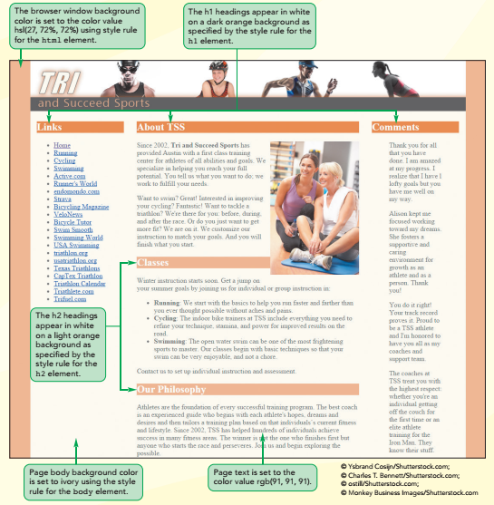
CSS Styles and Colors

Slide 5
Introducing CSS
The appearance of the page is determined by one or more style sheets written in the Cascading Style Sheets (CSS) language
The latest version of the CSS language is CSS3
CSS3 is built upon several modules, where each module is focused on a separate design topic

Slide 6
Types of Style Sheets
Browser styles or user agent styles – Styles built into the browser
User-defined styles – Styles defined by a user based on the configuration settings of the user’s browser
External styles – Styles created by a website author, placed within a CSS file, and linked to the website

Slide 7
Types of Style Sheets (continued)
Embedded styles – Styles added to the head of an HTML document
Inline styles – Styles added as element attributes within an HTML document and applied to only that particular element

Slide 8
Exploring Style Rules
The general syntax of a CSS style rule is
selector {
property1: value1;
property2: value2;
...
}
where selector identifies an element or a group of elements within the document and the property: value pairs specify the style properties and their values applied to that element or elements

Slide 9
Browser Extensions
Browser extensions are an extended library of style properties in the browser
Vendor prefix – Indicates the browser vendor that created and supports the style property

Slide 10
Browser Extensions (continued)
Vendor Prefix | Rendering Engine | Browsers
-Khtml- | KHTML | Konqueror
-moz | Mozilla | Firefox, Camino
-ms- | Trident | Internet Explorer
-o- | Presto | Opera, Nintendo Wii browser
-webkit- | WebKit | Android browser, Chrome, Safari

Slide 11
Embedded Style Sheets
They are inserted directly into the HTML file as metadata by adding the following style element to the document head:
<style>
style rules
</style>
where style rules are the different rules embedded in the HTML page

Slide 12
Inline Styles
They are styles applied directly to specific elements using the following style attribute
<element style=“property1: value1;
property2: value2; …”>
content
</element>
where the property: value pairs define the styles applied directly to that element

Slide 13
Style Specificity and Precedence
The more specific style rule has precedence over the more general style rule
Specificity is an issue when two or more styles conflict
If two rules have equal specificity and equal importance, then the one that is defined last has precedence

Slide 14
Style Inheritance
Style inheritance – Process in which properties are passed from a parent element to its children
For example, the following style rule sets the color of article text to blue and the rule is passed to any paragraph or other elements nested within that article
article {color: blue;}
p {text-align: center;}

Slide 15
Browser Developer Tools
They allow designers to view HTML code and CSS styles
They make it easier to locate the source of a style that has been applied to a specific page element
They are different in each browser and are updated and improved constantly

Slide 16
Creating a Style Sheet
Writing style comments
/* comment */
where comment is the text of the comment
Defining the character encoding
@charset "encoding";
where encoding defines the character encoding used in the file

Slide 17
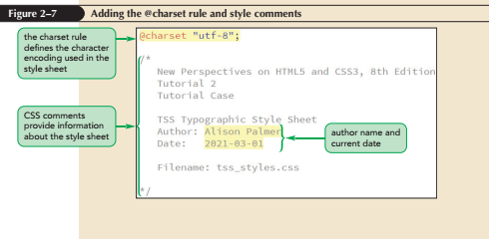
Creating a Style Sheet (continued 1)

Slide 18
Creating a Style Sheet (continued 2)
Importing style sheets
@import is a CSS at-rule used to import the content of a style sheet file
@import url(url);
where url is the URL of an external stylesheet file
It is similar to adding link elements to an HTML file

Slide 19
Working with Color in CSS
CSS supports 147 color names
Color values – Values in which the color is given by an exact numeric representation
RGB values and HSL values
RGB triplet – The intensity of primary colors expressed as a set of numbers
rgb(red, green, blue)
Hexadecimal numbers – A number expressed in the base 16 numbering system

Slide 20
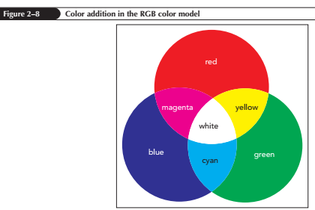
RGB Color Values

Slide 21
HSL Color Values
Hue – Tint of a color, represented by a direction on a color wheel
Saturation – Measures the intensity of a color and ranges from 0% (no color) up to 100% (full color)
Lightness – Measures the brightness of a color and ranges from 0% (black) up to 100% (white)

Slide 22
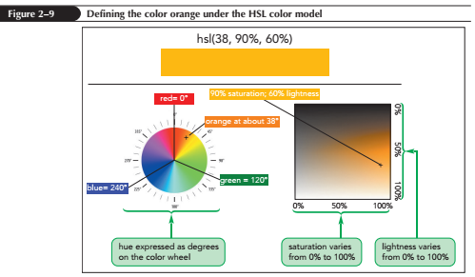
HSL Color Values (continued)

Slide 23
Defining Semi-Opaque Colors
Opacity – Defines how solid a color appears
A color’s opacity is specified using the following properties:
rgba(red, green, blue, opacity)
hsla(hue, saturation, lightness, opacity)
where opacity sets the opacity of the color ranging from 0 (completely transparent) up to 1.0 (completely opaque)

Slide 24
Setting Text and Background Colors
CSS defines the text and background color for each element on a webpage
color: color;
background-color: color;
where color is a color name or a color value

Slide 25
Employing Progressive Enhancement
Progressive enhancement – A technique of placing the code conforming to elder standards before newer properties
It provides support for older browsers and allows newer standards to be used by the browsers that support them

Slide 26
Exploring Selector Patterns
This style rule matches every h1 element in an HTML document, regardless of its location within the page:
h1 {
color: red;
}
To direct a style rule to an element at a specific location use selector patterns to match only those page elements that match a specified pattern

Slide 27
Contextual Selectors
Contextual selector – Specifies the context under which a particular page element is matched
Context is based on the hierarchical structure of a document, which involves the relationships between a parent element containing one or more child elements and within those child elements several levels of descendant elements

Slide 28
Contextual Selectors (continued 1)
Selector | Description
* | Matches any element
elem | Matches the element elem located anywhere in the document
elem1, elem2, … | Matches any of the elements elem1, elem2, etc.
parent descendant | Matches the descendant element that is nested within the parent element at some level
parent > child | Matches the child element that is a child of the parent element
elem1 + elem2 | Matches elem2 that is immediately preceded by the sibling element elem1
elem1 ~ elem2 | Matches elem2 that follows the sibling element elem1

Slide 29
Contextual Selectors (continued 2)
To match any element, a wildcard selector with the * character is used
Sibling selectors are used to select elements based on elements that are adjacent to them in the document hierarchy

Slide 30
Attribute Selectors
Selectors also can be defined based on attributes and attribute values within elements
id – Identifies specific elements within the document
Class – Identifies a group of elements that share a similar characteristic or property

Slide 31
Attribute Selectors (continued 1)
Selector | Selects | Example | Selects
elem#id | Element elem with the ID value id | h1#intro | The h1 heading with the id intro
#id | Any element with the ID value id | #intro | Any element with the id intro
elem.class | All elem elements with the class attribute value class | p.main | All paragraphs belonging to the main class
.class | All elements with the class value class | .main | All elements belonging to the main class
elem [att] | All elem elements containing the att attribute | a[href] | All hypertext elements containing the href attribute
elem [att=”text”] | All elem elements whose att attribute equals text | a[href=”top.html”] | All hypertext elements whose href attribute equals top.html

Slide 32
Attribute Selectors (continued 2)
Selector | Selects | Example | Selects
elem [att~=”text”] | All elem elements whose att attribute contains the word text | a[rel~=”glossary”] | All hypertext elements whose rel attribute contains the word glossary
elem [att|=”text”] | All elem elements whose att attribute value is a hyphen-separated list of words beginning with text | p[id|=”first”] | All paragraphs whose id attribute starts with the word first in a hyphen-separated list of words
elem [att^=”text”] | All elem elements whose att attribute begins with text | a[rel^=”prev”] | All hypertext elements whose rel attribute begins with prev
elem [att$=”text”] | All elem elements whose att attribute ends with text | a[href$=”org”] | All hypertext elements whose href attribute ends with org
elem [att*=”text”] | All elem elements whose att attribute contains the value text | a[href*=”faq”] | All hypertext elements whose href attribute contains the text string faq

Slide 33
Working with Fonts
Typography is the art of designing the appearance of characters and letters on a page
Color and font are one of few properties in the CSS family of typographical styles

Slide 34
Choosing a Font
Text characters are based on fonts that define the style and appearance of each character in the alphabet
The general structure of defining font for any page element is
font-family: fonts;
where fonts is a comma-separated list,
also known as a font stack

Slide 35
Choosing a Font (continued 1)
Specific font – Identified by name and based on a font definition file stored in a user’s computer or accessible on the web
Generic font – Describes the general appearance of the characters in the text but does not specify any particular font definition file
Supports the font groups serif, sans-serif, monospace, cursive, and fantasy

Slide 36
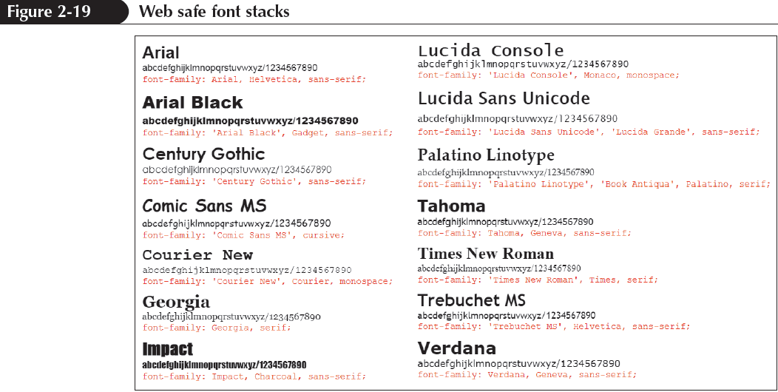
Choosing a Font (continued 2)

Slide 37
Exploring Web Fonts
Web font – Definition font is supplied to the browser in an external file because web safe fonts limit the number of fonts choices
The format most universally accepted in almost all current browsers and on almost all devices is the Web Open Font Format (WOFF)

Slide 38
Exploring Web Fonts (continued)
Format | Description | Browser
Embedded OpenType (EOT) | A compact form of OpenType fonts designed for use as embedded fonts in style sheets | Internet Explorer (IE)
TrueType (TTF) | Font standard used on the Mac OS and Microsoft Windows operating systems | IE, Firefox, Chrome, Safari, Opera
OpenType (OTF) | Font format built on the TrueType format developed by Microsoft | IE, Firefox, Chrome, Safari, Opera
Scalable Vector Graphics (SVG) | Font format based on an XML vocabulary designed to describe resizable graphics and vector images | Safari
Web Open Font Format (WOFF) | The W3C recommendation font format based on OpenType and TrueType with compression and additional metadata | IE, Firefox, Chrome, Safari, Opera

Slide 39
The @font-face Rule
To access and load a web font, add the @font-face rule to the style sheet
Once a web font is defined using the @font-face rule, it is included in the font stack

Slide 40
The @font-face Rule (continued 1)
General syntax to include @font-face
@font-face {
font-family: name;
src: url (‘url1’) format (‘text1’),
url (‘url2’) format (‘text2’),
…;
descriptor1: value1;
descriptor2: value2;
…
}

Slide 41
The @font-face Rule (continued 2)
where name is the name of the font, url is the location of the font definition file, text is an optional text description of the font format, and the descriptor1: value1; pairs are optional style properties of the font

Slide 42
Setting the Font Size
To set a text size, use font-size: size;
where size is a CSS unit of length in either relative or absolute units
Absolute units – Fixed in size regardless of the output device and are used only with printed media
Relative units – Expressed relative to the size of other objects within the web page or to the display properties of the device itself

Slide 43
Scaling Fonts with ems and rems
Text is made scalable with all font sizes expressed relative to default font sizes
The three relative measurements used to provide scalability are:
percentage
em unit
rem or root em unit

Slide 44
Using Viewport Units
Viewport unit – A relative unit used to express length as a percentage if the width and height if the browser window
CSS3 introduced four viewport units
1 vw = 1% of the browser window width
1 vh = 1% of the browser window height
1 vmin = 1 vw or 1 vh (whichever is smaller)
1 vmax = 1 vw or 1 vh (whichever is larger)

Slide 45
Sizing Keywords
Font sizes are expressed using the following keywords
xx-small
x-small
small
medium
large
x-large
xx-large
larger
smaller

Slide 46
Controlling Spacing and Indentation
Kerning sets the space between characters, while tracking sets the space between words
The properties to control an element’s kerning and tracking are:
letter-spacing: value;
word-spacing: value;

Slide 47
Controlling Spacing and Indentation (continued 1)
Leading – sets the space between lines of text and is defined with the following line-height property:
line-height: size;
Text spacing can be controlled by setting the indentation for the first line of text block by using the text-indent property
text-indent: size;
A negative indentation value creates a hanging indent

Slide 48
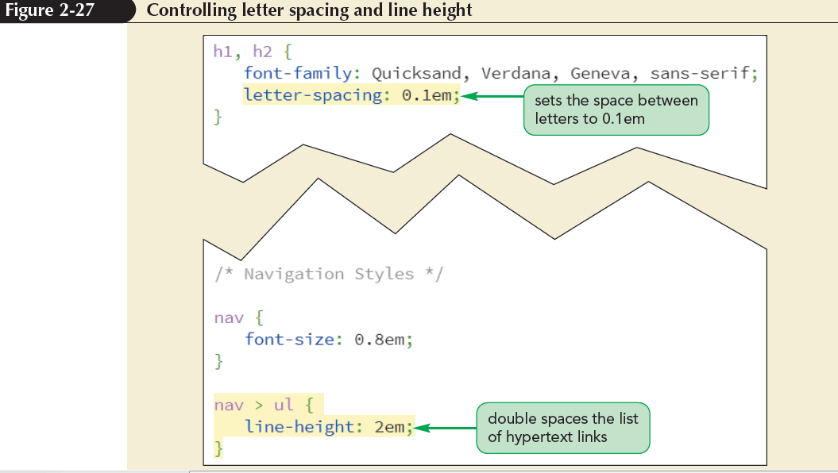
Controlling Spacing and Indentation (continued 2)

Slide 49
Working with Font Styles
To specify the font style, use
font-style: type;
where type is normal, italic, or oblique
To change the weight of the font, use
font-weight: weight;
where weight is the level of bold formatting applied to the text

Slide 50
Working with Font Styles (continued 1)
To specify a text decoration, use
text-decoration: type;
where type is none, underline, overline, or line-through
To transform text, use
text-transform: type;
where type is capitalize, uppercase, lowercase, or none

Slide 51
Working with Font Styles (continued 2)
To display a font variant of text, use
font-variant: type;
where type is normal or small-caps

Slide 52
Aligning Text Horizontally and Vertically
To horizontally align the text , use
text-align: alignment;
where alignment is left, right, center, or justify
To vertically align the text within each line, use
vertical-align: alignment;
where alignment is baseline, bottom, middle, sub, super, text-bottom, text-top, or top

Slide 53
Aligning Text Horizontally and Vertically (continued 1)
Value | Description
baseline | Aligns the baseline of the element with the baseline of the parent element
bottom | Aligns the bottom of the element with the bottom of the lowest element in the line
middle | Aligns the middle of the element with the middle of the surrounding content in the line
sub | Subscripts the element
super | Superscripts the element
text-bottom | Aligns the bottom of the element with the bottom of the text in the line
text-top | Aligns the top of the element with the top of the text in the line
top | Aligns the top of the element with the top of the tallest object in the line

Slide 54
Combining All Text Formatting in a Single Style
The text and font styles can be combined using the following shorthand font property:
font: style variant weight size/height family;
where style is the font’s style, variant is the font variant, weight is the font weight, size is the font size, height is the height of each line, and family is the font stack

Slide 55
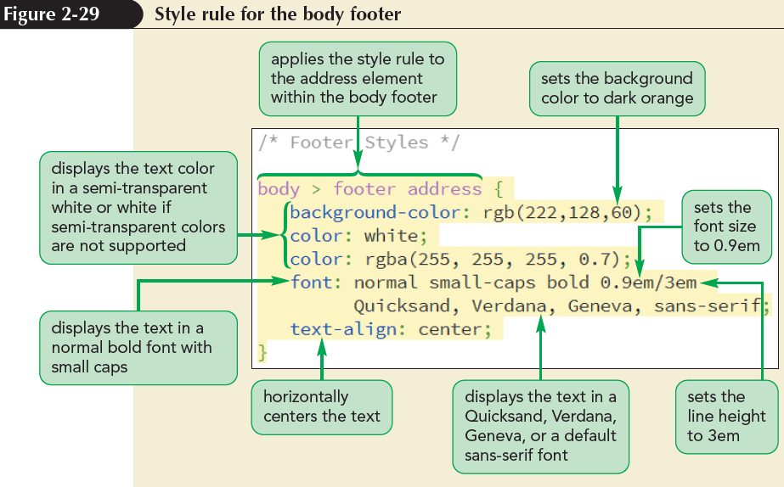
Combining All Text Formatting in a Single Style (continued 1)

Slide 56
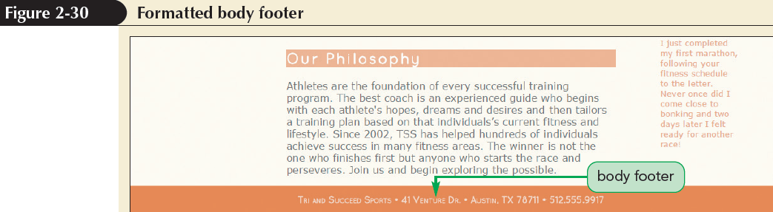
Combining All Text Formatting in a Single Style (continued 2)

Slide 57
Choosing a List Style Type
List marker – It is the default browser style symbol displayed before each list item for unordered and ordered lists
To change the type of list marker or to prevent any display of a list marker, use
list-style-type: type;
where type is the various types of markers

Slide 58
Choosing a List Style Type (continued)
list-style-type | Marker(s)
disc | 
circle | 
square | ○
decimal | 1, 2, 3, 4, …
decimal-leading-zero | 01, 02, 03, 04, …
lower-roman | i, ii, iii, iv, …
upper-roman | I, II, III, IV, …
lower-alpha | a, b, c, d, …
upper-alpha | A, B, C, D, …
lower-greek | α, β, γ, δ, …
upper-greek | Α, Β, Γ, Δ, …
none | no marker displayed

Slide 59
Creating an Outline Style
Nested lists can be displayed in an outline style using contextual selectors
The following style rules create an outline style for a nested ordered list:
ol {list-style-type: upper-roman;}
ol ol {list-style-type: upper-alpha;}
ol ol ol {list-style-type: decimal;

Slide 60
Using Images for List Markers
A customized graphic image for the list marker can be supplied by the user
list-style-image: url (url);
where url is the URL of a graphic file containing the marker image

Slide 61
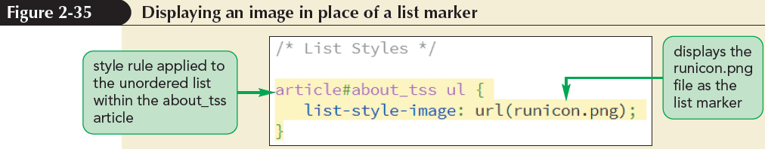
Using Images for List Markers (continued 1)

Slide 62
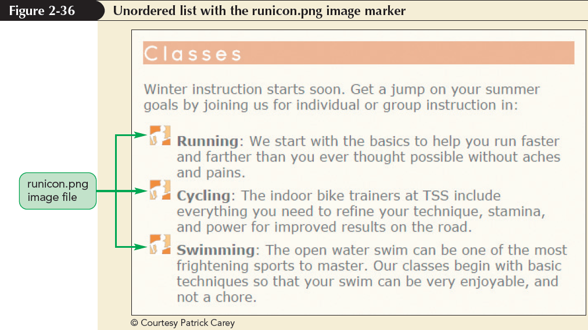
Using Images for List Markers (continued 2)

Slide 63
Setting the List Marker Position
CSS treats each list item as a block-level element, placed within a virtual box in which the list marker is placed outside of the list text
To change the default behaviour, use
list-style-position: position;
where position is either outside or inside

Slide 64
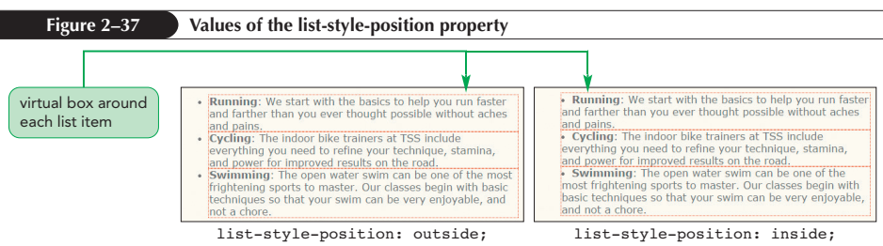
Setting the List Marker Position (continued)

Slide 65
Working with Margins and Padding
Block-level elements follow the structure of the box model
Contents in a box model are enclosed within the following series of nested boxes:
The content of the element itself
The padding space, which extends from the element’s content to a border
The border surrounding the padding space
The margin space comprised of the space beyond the border up to the next page element

Slide 66
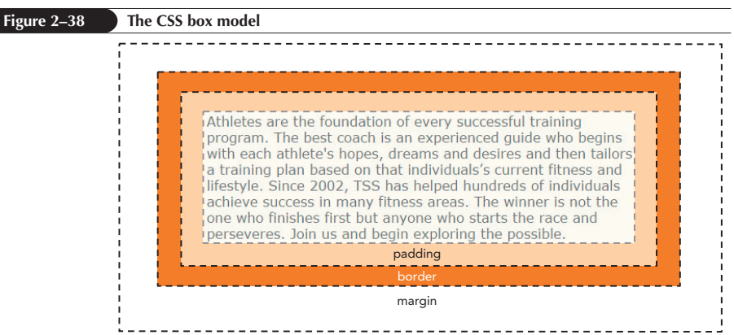
Working with Margins and Padding (continued)

Slide 67
Setting the Padding Space
To set the width of the padding space, use the following padding property
padding: size;
where size is expressed in one of the CSS units of length or the keyword auto to let the browser automatically choose the padding

Slide 68
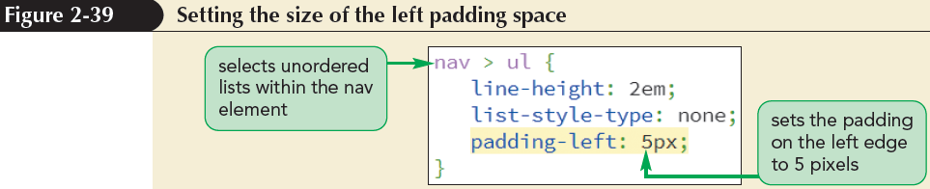
Setting the Padding Space (continued)

Slide 69
Setting the Margin and the Border Spaces
To set the size of the margin around block elements, use
margin: size;
margin: top right bottom left;
To set the size of the border space, use
border-width: size;
border-width: top right bottom left;

Slide 70
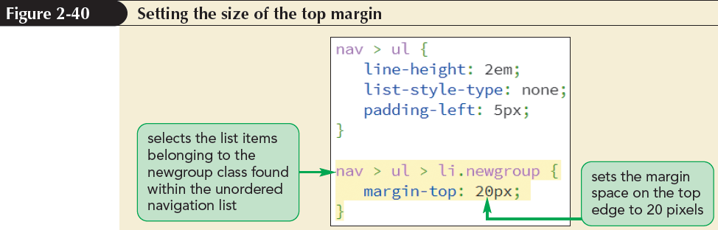
Setting the Margin and the Border Spaces (continued)

Slide 71
Using Pseudo-Classes and Pseudo-Elements
Pseudo-class – classifies an element based on its current status, position, or use in the document
element: pseudo-class
where element is an element from the document and pseudo-class is the name of a CSS pseudo-class
Structural pseudo-class – classifies an element based on its location within the structure of the HTML document

Slide 72
Using Pseudo-Classes and Pseudo-Elements (continued 1)
Pseudo-Class | Matches
:root | The top element in the document hierarchy (the html element)
:empty | An element with no content
:only-child | An element with no siblings
:first-child | The first child of the parent element
:last-child | The last child of the parent element
:first-of-type | The first descendant of the parent that matches the specified type
:last-of-type | The last descendant of the parent that matches the specified type
:nth-of-type(n) | The n^{th} element of the parent of the specified type
:nth-last-of-type(n) | The n^{th} from the last element of the parent of the specified type
:only-of-type | An element that has no siblings of the same type
:lang(code) | The element that has the specified language indicated by code
:not(selector) | An element not matching the specified selector

Slide 73
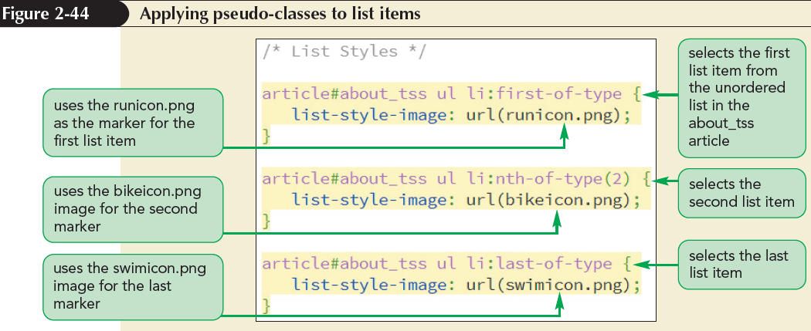
Using Pseudo-Classes and Pseudo-Elements (continued 2)

Slide 74
Pseudo-classes for Hypertext
Dynamic pseudo-class – A type of pseudo-class in which the class can change state based on the actions of the user

Slide 75
Pseudo-classes for Hypertext (continued)
Pseudo-Class | Description
:link | The link has not yet been visited by the user.
:visited | The link has been visited by the user.
:active | The element is in the process of being activated or clicked by the user.
:hover | The mouse pointer is hovering over the element.
:focus | The element is receiving the focus of the keyboard or mouse pointer.

Slide 76
Pseudo-Elements
Pseudo-element – An object that exists only in the rendered page
Pseudo-elements can be selected using the following CSS selector:
element::pseudo-element
where element is an element from the HTML file and pseudo-element is the name of a CSS pseudo-element

Slide 77
Pseudo-Elements (continued)
Pseudo-Element | Description
::first-letter | The first letter of the element text
::first-line | The first line of the element text
::before | Content inserted directly before the element
::after | Content inserted directly after the element

Slide 78
Generating Content with CSS
New content can be added either before or after an element using the following before and after pseudo-elements:
element::before {content: text;}
element::after {content: text;}
where text is the content to be inserted into the rendered web page

Slide 79
Generating Content with CSS (continued)
Value | Description
none | Sets the content to an empty text string
counter | Displays a counter value
attr(attribute) | Displays the value of the selector’s attribute
text | Displays the specified text
open-quote | Displays an opening quotation mark
close-quote | Displays a closing quotation mark
no-open-quote | Removes an opening quotation mark, if previously specified
no-close-quote | Removes a closing quotation mark, if previously specified
url(url) | Displays the content of the media (image, video, etc.) from the file located at url

Slide 80
Displaying Attribute Values
The content property can be used to insert an attribute value into the rendered web page using the attr( ) function
content: attr(attribute);
where attribute is an attribute of the selected element

Slide 81
Inserting Quotation Marks
The blockquote and q elements are used for quoted material
Decorative opening and closing quotation marks can be inserted using the content property as follows:
content: open-quote;
content: close-quote;

Slide 82
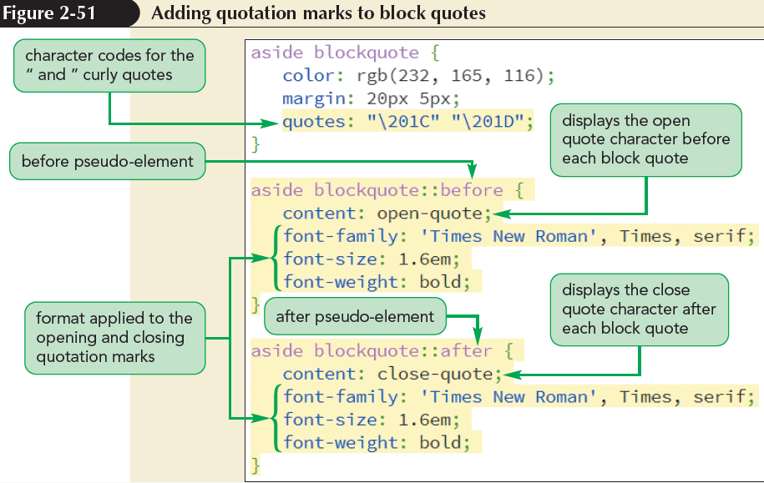
Inserting Quotation Marks (continued)

Slide 83
Validating Your Style Sheet
Browsers are very unforgiving about CSS errors
Submit a CSS style sheet for validation, either to a web content management system or to the validation site at the W3C
If using a validator, first add a deliberate error to the code to see how the CSS validator works

